Slide 1
Lekhit & Sarvesh
AUDIT: Anomalous User Detection via Intelligent Tracking
Detect the unexpected. Protect the normal.

Slide 2
What is AUDIT?
AUDIT PILLARS
WHAT IT DOES
WHAT IT ACCESSES
WHAT IT PRODUCES
Detects anomalous user behaviour in real time using a self-supervised Transformer model trained purely on clean endpoint telemetry
(no labelled attack data required)
Live endpoint events via eslogger - event type, actor name, file paths, process execution, timestamps, network connections.
A calibrated anomaly probability P(Anomalous) per user session
“AUDIT learns what normal looks like — so anything else stands out.”

Slide 3
Data Generation & Ingestion
  Source: user_behavior.jsonl — raw endpoint telemetry
  Parsed into Pandas (dev)
  Malformed/null rows dropped at ingestion; drop rate logged per batch
  Key fields retained: event_type_id, actor_name, target_path, hour, day_of_week
  session_id used as grouping key only — not a model feature
  Unknown actors assigned <UNK> token → triggers population-level scoring

Slide 4
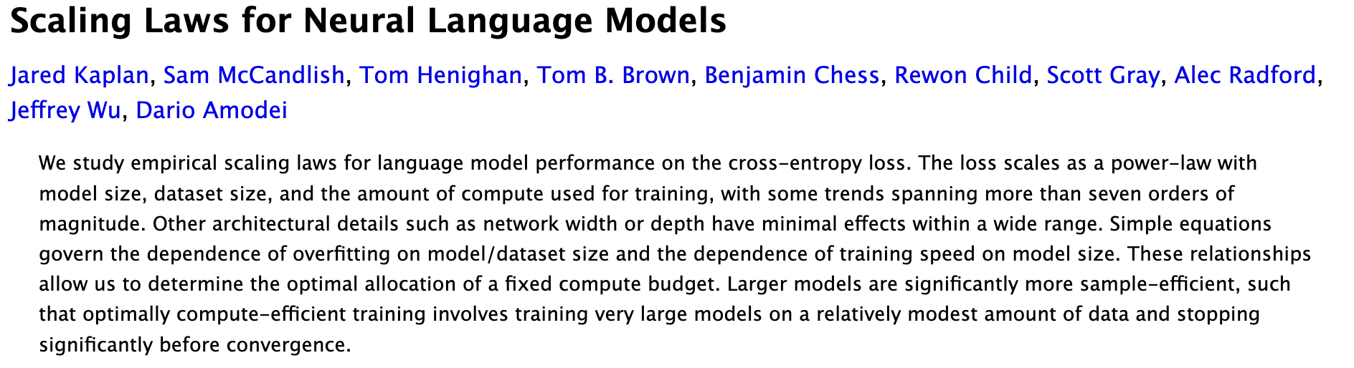

Slide 5
Feature Encoding & Sequence Construction
  Encoding table:
    event_type_id → Learned embedding (dim 32)
    actor_name → Learned embedding + <UNK> token (dim 64)
    target_path → BPE tokenizer, vocab ~8k (dim 64)
    hour / day_of_week → Sine/cosine cyclical encoding (dim 4)
    is_platform_binary → Binary scalar 0/1
    timestamp → Time2Vec with inter-event Δt
  All fused → projected to d_model = 256 via Linear + LayerNorm
  Sequences grouped by session_id, sorted by timestamp
  Fixed length L = 128 | Short → right-pad with [PAD] | Long → sliding window, stride 64
  Special tokens: [CLS] prepended, [SEP] appended

Slide 6
  Masked Event Modeling (MEM): Inspired by AnomalyBert( Masked reconstruction for Anomaly Detection)
    Multi-field embedding: separate nn.Embedding per sub-vocabulary, outputs summed
    Transformer encoder: N layers of multi-head self-attention + FFN with GELU, pre-norm
    Prediction heads: three linear heads to reconstruct masked fields (event_type, actor, target)
    Small footprint: d_model=128, 4 heads, 4 layers, d_ff=512
Transformer Architecture : Design Choices

Slide 7
  Masked Event Modeling (MEM): Randomly mask 15% of non-[PAD], non-[CLS] events
    80% → [MASK] token
    10% → random event token
    10% → left unchanged
  Prediction head: 3-layer MLP → predicts original event_type_id at masked positions
  Loss: Cross-entropy at masked positions only
  Training data: Clean-period only (exclude first/last week to avoid boundary contamination)
  Validation: Held-out 10% of clean sessions
Self Supervised Training

Slide 8
Anomaly Scoring & Calibration
  Anomaly scoring: Multiple masking passes over a window; anomaly score per event = negative log-probability of the true token under the model. High score = the model didn't expect this event in this context.
  User profiling: Extract [CLS] embedding per window → average over time → user behavior vector. Track cosine similarity over time to detect behavioral drift.
  Real-time mode: Maintain a sliding window from live eslogger stream, score each window as it fills.

Slide 9
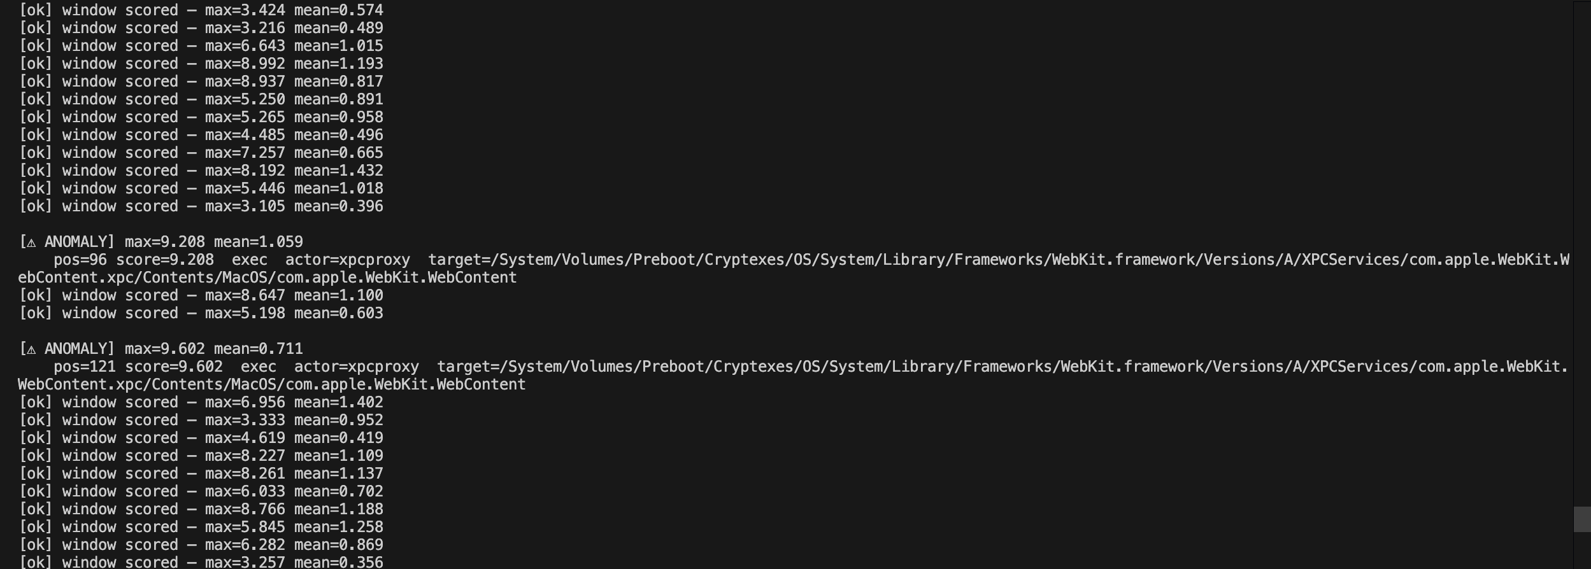

Slide 10
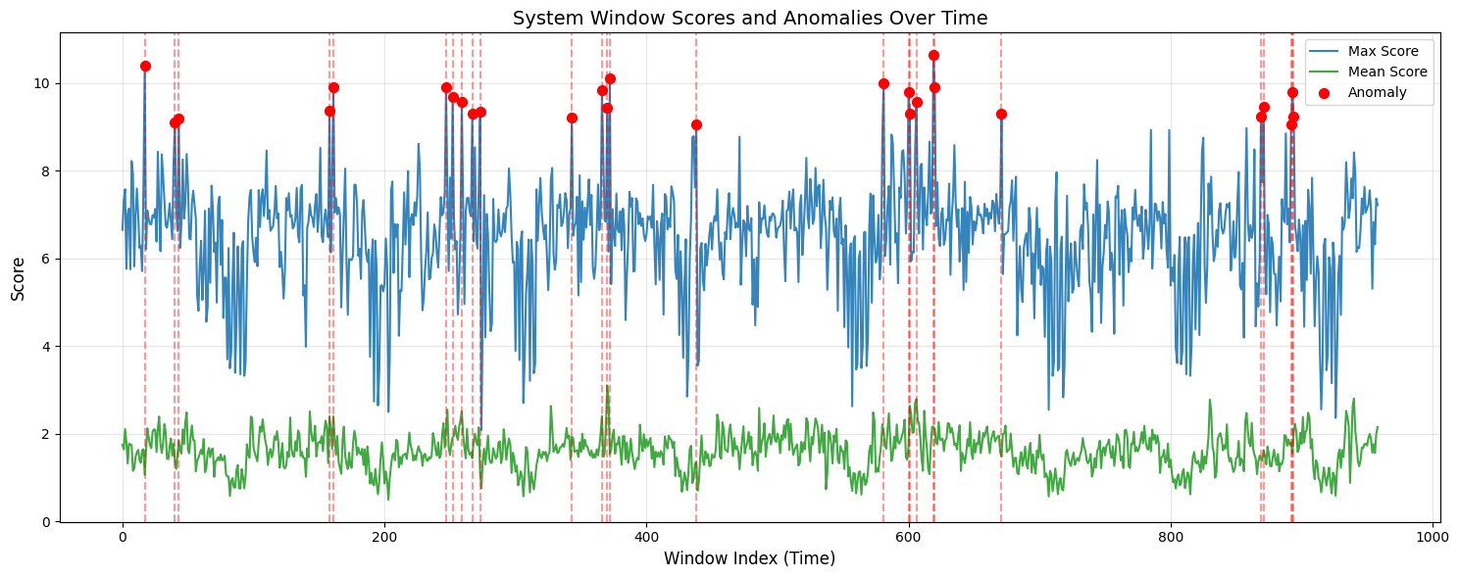

Slide 11
Ongoing Challenges
Identify the 3 most critical challenges that must be addressed to achieve the primary goal.
MODEL
DATA
DRIFT
COLD START
MATURITY
ADVERSARIAL EVASION
ADVERSARIAL EVASION
Focus on root causes, not surface symptoms.

Slide 12
Future Scope
MULTI-MODAL FUSION
LLM INTEGRATION
INSIDER THREAT PROFILING
SAAS DEPLOYMENT MODE
ATTACKER PERSONA CLASSIFICATION
HARDWARE ANOMALY CORRELATION

Slide 13
Conclusion
  AUDIT turns raw endpoint telemetry into a living, per-user behavioural model — trained on normality, alert on deviation
  Self-supervised approach means zero dependency on labelled attack data — deployable from day one
  Calibrated scoring + attention explainability means alerts analysts can act on, not just noise
  Rolling recalibration means the system stays current as users and environments evolve
  The architecture is production-ready in design — the next phase is hardening, scaling, and stress-testing
"Every anomaly has a paper trail. AUDIT finds it.

Slide 14
Questions?
  Are there better way to factor for time variance in sequence of events?
  Will it be better to utilize the pre-existing structure for events, Or should we stick to completely tokenized approach as followed in NLP tasks?
  What percent of CPU processing and Memory resource should a AUDIT like system target? Should there be hard bounds? Or does security take highest priority?
"Every anomaly has a paper trail. AUDIT finds it.

